Slide 1
Chemistry 3A
Introductory General Chemistry
Scientific Method, Atomic Theory, Properties of Atoms, Isotopes, Atomic Mass Calculations
S. M. Halloran

Slide 2
Concepts
Scientific Method
Atomic Theory
Subatomic Structure: protons, electrons, neutrons
Atomic Properties
Patterns of matter: Periodic Table
Electric properties of atoms: ions
Neutrons and isotopes
Periodic table atomic mass: average of atom’s isotopes’ masses

Slide 3
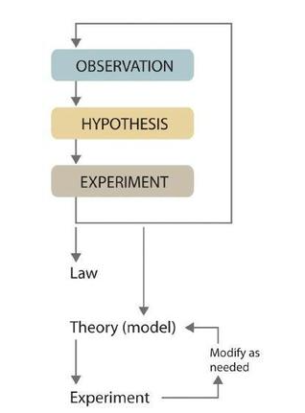
Scientific Method
Terms You Should Know
Observation
Hypothesis
Experiment
Theory (or model)
Law

Slide 4
Scientific Method
Observations
the active gathering of information from the natural world using the human senses or scientific instruments
Qualitative
  properties or occurrences in ways that do not rely on numbers
  table salt is crystalline solid
  dilute nitric acid used to dissolve penny forms blue solution and brown gas
  air temperature is cooler in winter season
Quantitative
  numerical measurements
    data has number with units!
  melting point of crystalline sulfur → 115.21°C
  35.9 g sodium chloride (NaCl) will dissolve in 100 g water at 20 °C
  Iridium in sediments from 66 million years ago were 20-160 times higher than normal

Slide 5
Scientific Method
Hypothesis
A tentative explanation to account for (set of related) observations
Two hypotheses to account why sun rises in east and sets in the west
  Sun revolves around the Earth
  geocentric hypothesis for observation
  Earth rotates on an axis, exposing only one side to sun
  heliocentric hypothesis for observation
Iridium levels observation brought hypothesis that dinosaur extinction event by large extraterrestrial object hitting Earth

Slide 6
Scientific Method
Experiment
Systematic observations or measurements, preferably made under controlled conditions—that is, under conditions in which a single variable changes
These are designed to test validity of a hypothesis (more experiments test additional hypotheses)
Experimental results should show if hypothesis is correct or sound or needing to be modified or revised
A wrong hypothesis does not mean there are problems with scientific method or with “doing science”. It means an educated guess was made, was not true in whole or in part, and a new guess is needed

Slide 7
Scientific Method
n = 3, not n = 1
Experimental results should be reproducible, that is repeated experiments
  n refers to the number of times an experiment under identical conditions is to be done to get results which should be reproduced to prove the reliability, dependability, precision, accuracy of observations
  It is generally accepted an experiment should be done 3 times (n = 3) to show results are reproducible. It is never acceptable to do an experiment only once (n = 1)

Slide 8
Scientific Method
Theory
A broad, deeply tested framework explaining why a phenomenon happens
the affirmation of many related hypotheses
Evolution, Germ Theory
Law
A descriptive statement or mathematical equation that predicts what will happen under specific conditions
Gravity

Slide 9
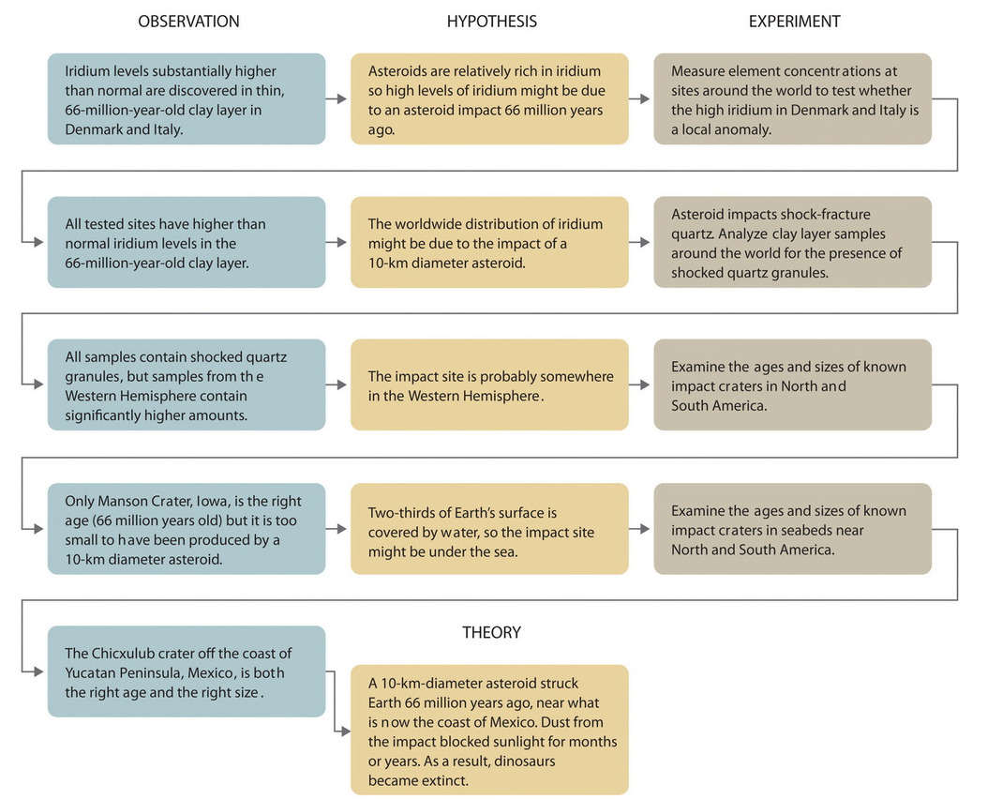
Scientific Method
Asteroid Theory and Dinosaur Extinction
Development of a Theory
Observation → Hypothesis → Experiment
repeated cycles
These cycles
follow the idea that
an asteroid caused
the extinction
of large reptiles
(the “dinosaurs”)

Slide 10
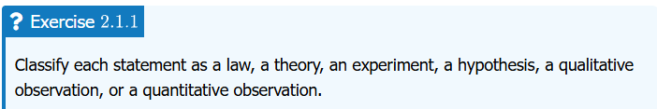






Let’s Have A Quiz

Slide 11
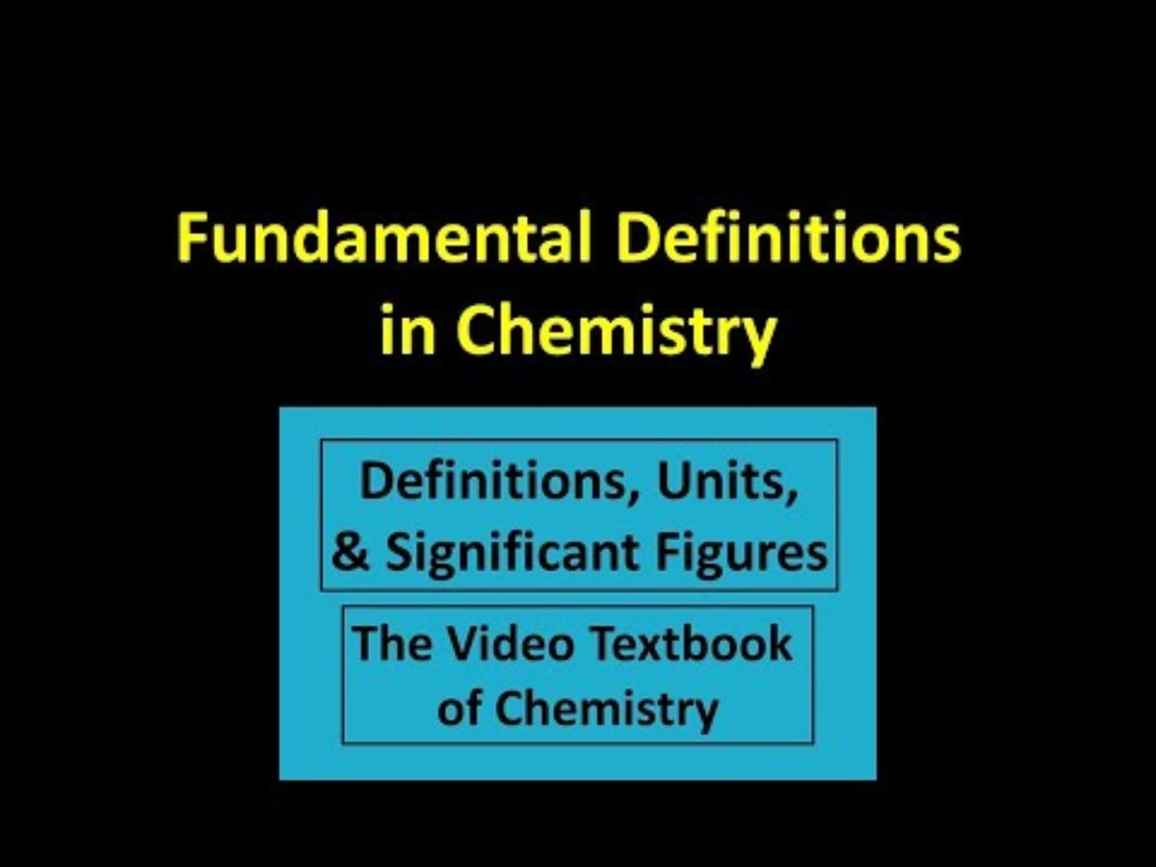
You learn through videos, podcasts?
Or by books and the reading of thousands of words?
GLOSSARY for this course to be updated and put up soon
This video
resource at
right in your
course
textbook

Slide 12
Atomic Theory
A couple of millennia* ago, Greek philosophers talked about matter as made of atoms
  Tiny, indivisible, solid objects
But it was only a couple of centuries ago (1800s) that experimental science really propelled humanity forward
English chemist John Dalton (researcher, professor)
  Studied combustion: carbon reacting with oxygen
    Elements were already known for millennia
  Knew water had elements hydrogen and oxygen
  Proposed a theory based on experimental results that “the known elements are actually composed of atoms”
*Science is also about history, a history showing learning through trial-and-error & progression of thought and knowledge

Slide 13
Dalton’s Atomic Theory
All matter made of indivisible atoms
  Atoms are smallest units of matter
  Atoms cannot be created, divided, or destroyed (later revised with the discovery of subatomic particles)
All atoms of a given element are identical
  Atoms of the same element have same mass and properties
  later revised—atoms of the same element can have different masses known as isotopes
Compounds are formed by a combination of atoms of different elements
  A given compound always contains the same kinds and ratios of atoms
Chemical reactions involve the rearrangement of atoms
  Atoms are neither created nor destroyed in a chemical reaction—only rearranged
Atoms are about 5.4 x 10⁻¹⁰ m in diameter
    = 0.54 nanometer (nm) or 5.4 angstrom (Å)

Slide 14
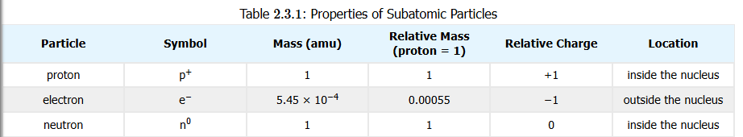
Subatomic Structure
Chemists see the atom structure having the important properties of mass and (electric) charge
Electrons
  mass = 9.109 x 10⁻³¹ kg, 5.486 x 10⁻⁴ amu
  charge = -1
Protons
  mass = 1.673 x 10⁻²⁷ kg, 1.007 amu, 1836 times electron mass
  charge = +1
Neutrons
  mass = 1.675 x 10⁻²⁷ kg, 1.009 amu, 1.001 times proton mass
  charge = 0

Slide 15
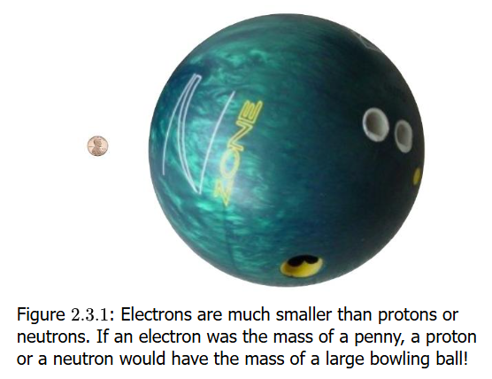
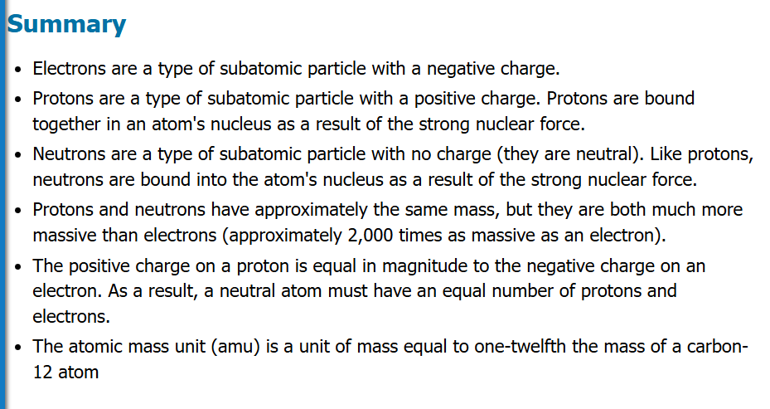
Subatomic Structure

Slide 16
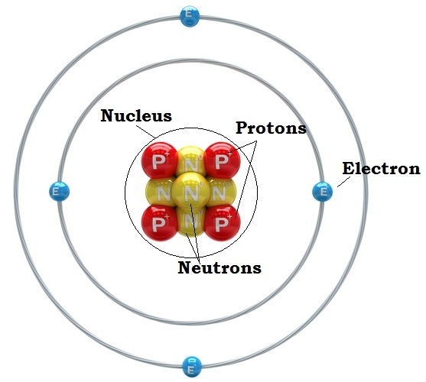
Nucleus & Orbitals
Protons and neutrons organized in the nucleus
Electrons spatially located outside of the nucleus
Electrons "orbit" the nucleus in orbitals but not like planets revolving around the sun
Their position/location is determined by probabilities calculated by
complex mathematical expressions
Each orbital pairs two electrons
of opposite spin
  Yes, electrons have a spin just
  as the Earth rotates on an axis,
  and this spin generates a
  magnetic field

Slide 17
Atomic Mass Units (amu)
Definition of “amu” is 1/12th of mass of carbon-12 atom (has 6 protons, 6 neutrons, 6 electrons)
This is not equal to mass of one proton, which is actually equal to 1.007276 amu
This is only of importance to physicists and is explained by the “mass deficit” which is the energy to that holds a nucleus together

Slide 18
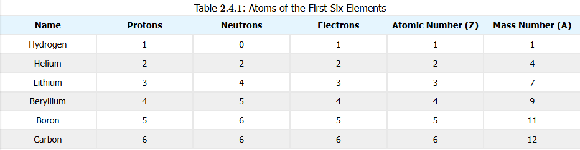
Atomic Properties
Atomic Number (the Z value)
  essentially defines the element
    makes hydrogen, oxygen, carbon, chlorine, etc. what it is
  = number of protons (in atom’s nucleus)
Mass Number (the A value)
  = sum of count of protons and neutrons in atom’s nucleus
  represents p⁺ + n⁰ count of one of element’s isotopes

Slide 19
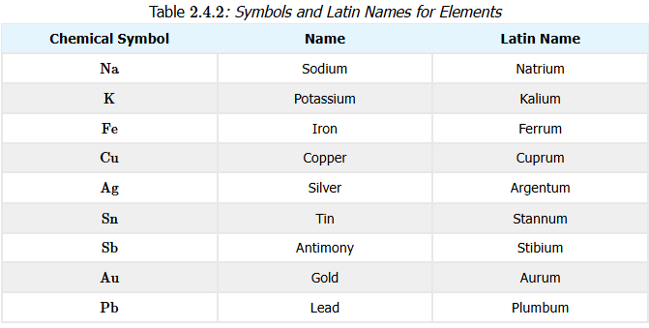
Atomic Properties
Names and Symbols
Elements have names and 1- or 2-character symbols that represent the element
Atoms are the physical part of the element
Learn the names and symbols of common elements

Slide 20
Isotopes
Elements can have different mass number (A) values. Chemistry is same though.
Hydrogen = 1 proton (99.9885%)
Deuterium (“hydrogen-2”) = 1 proton + 1 neutron (0.0115%)
Tritium (“hydrogen-3”) = 1 proton + 2 neutrons (1 in 10¹⁸)
  radioactive (beta emitter)
Carbon-12 = 6 protons + 6 neutrons (98.93%)
Carbon-13 = 6 protons + 7 neutrons (1.07%)
Carbon-14 = 6 protons + 8 neutrons (trace)
Isotopic abundance values in parentheses

Slide 21
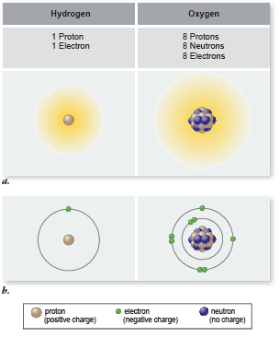
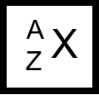
Elements
Elements all have the same
number of protons
But elements can have different
number of neutrons
An element with different
numbers of neutrons is
an isotope of the element
When referring to an isotope of an element,
use this
Where
× is element symbol (e. g., hydrogen = H)
Z is atomic number, = # protons (Z = 1 for H)
A is mass number, = #protons + #neutrons

Slide 22
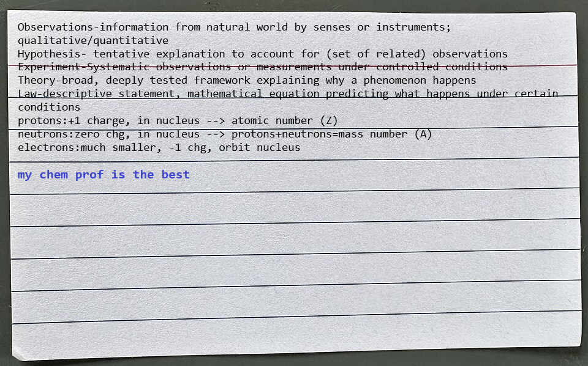
3 x 5 index card for exam
You are allowed for midterm exam a 3 x 5 index card of notes. For Midterm 1, you can write on both sides of card. Notes must be handwritten

Slide 23
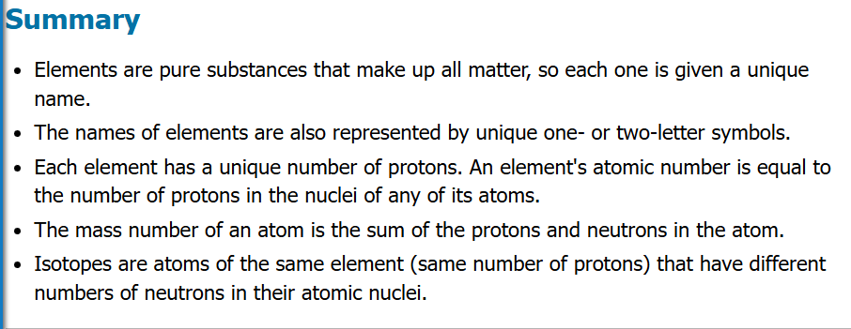

Slide 24
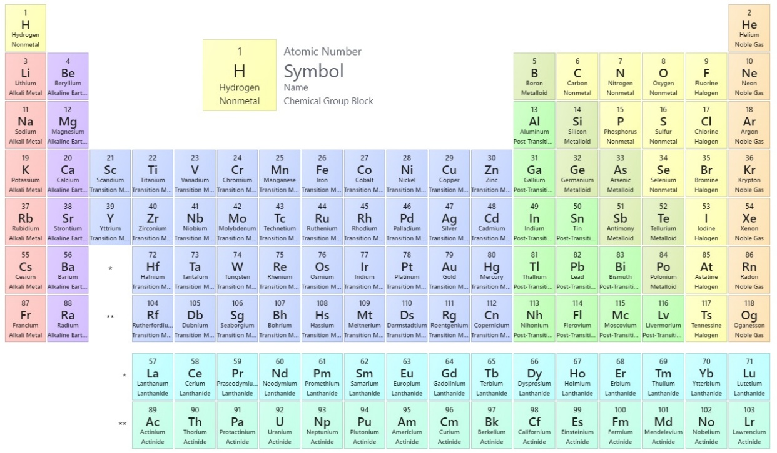
Patterns of Matter: Periodic Table
Observations
  chlorine, bromine, iodine react with sodium
  lithium, sodium, potassium react with other elements in similar ways
Organizing elements with these properties by Mendeleev (also Meyer)
  Symbols
    Element name (optional)
  Atomic Number
  Atomic Weight
    Not the mass number!
The modern Periodic Table
https://chem.libretexts.org/Ancillary_Materials/Reference/Periodic_Table_of_the_Elements

Slide 25
Features of Periodic Table
Periods
  The rows of the table
  Number of elements in period not always same!
    Pattern: 2, 8, 8, 18, 18, 32, 32 for the seven periods
    Physical reason for this important in chemistry
    Special periods: inner transition metals, lanthanides, actinides
Groups (“Families”)
  The columns of the table
  Usually have similar chemistry (chemical properties)

Slide 26
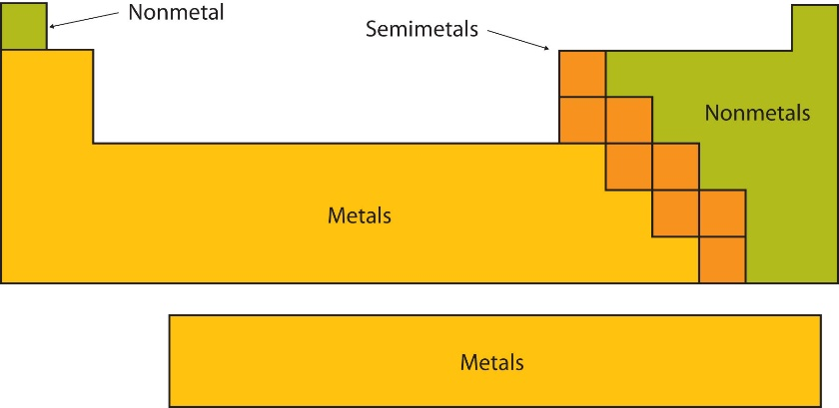
Patterns of Matter: Periodic Table
Classes of elements
Metals
  “shiny”, “silvery in color” (but varies)
  usually electrical and heat conductors
  malleable (hammer into sheets)
  ductile (pulled into wires)
Nonmetals
  not shiny, brittle in solid form
  poor electrical and heat conductors
“Metalloids” (Semimetals)
  between metal and nonmetal: B, Si, Ge, As, Sb, Te
  metallic luster, solid at room temperature
  brittle (not malleable)
  semiconductors: useful when “doped” with impurities
3/4ths of elements are metals

Slide 27
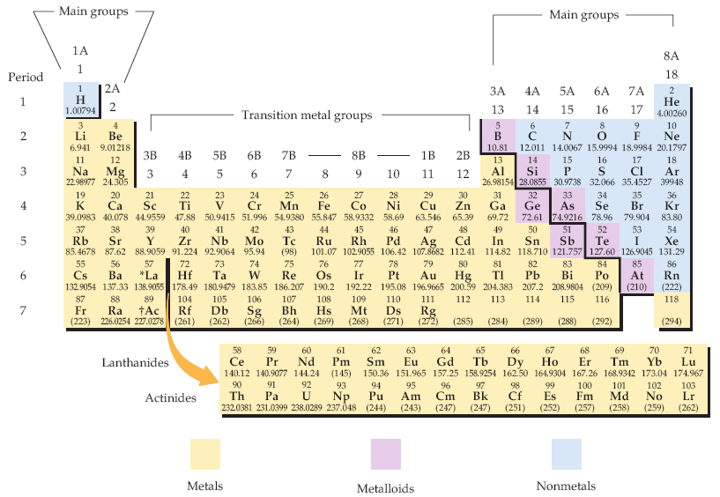
Periodic Table of Elements
Biologists should know what elements are
(1) metals and (2) nonmetals generally
The periodic table of the elements. Each element is identified by a one- or two-letter symbol and is characterized by an atomic number. The table begins with hydrogen (H, atomic number 1) in the upper left-hand corner and continues to the yet unnamed element with atomic number 118. The 14 elements following lanthanum (La, atomic number 57) and the 14 elements following actinium (Ac, atomic number 89) are pulled out and shown below the others.
Elements are organized into 18 vertical columns, or groups, and 7 horizontal rows, or periods. The two groups on the left and the six on the right are the main groups; the ten in the middle are the transition metal groups. The 14 elements following lanthanum are the lanthanides, and the 14 elements following actinium are the actinides; together these are known as the inner transition metals. Two systems for numbering the groups are explained in the text. Those elements (except hydrogen) on the left-hand side of the zigzag line running from boron (B) to astatine (At) are metals, those elements to the right of the line are nonmetals, and most elements abutting the line are metalloids.
McMurry et al, Fundamentals of General, Organic and Biological Chemistry, 6 Ed, p 58

Slide 28
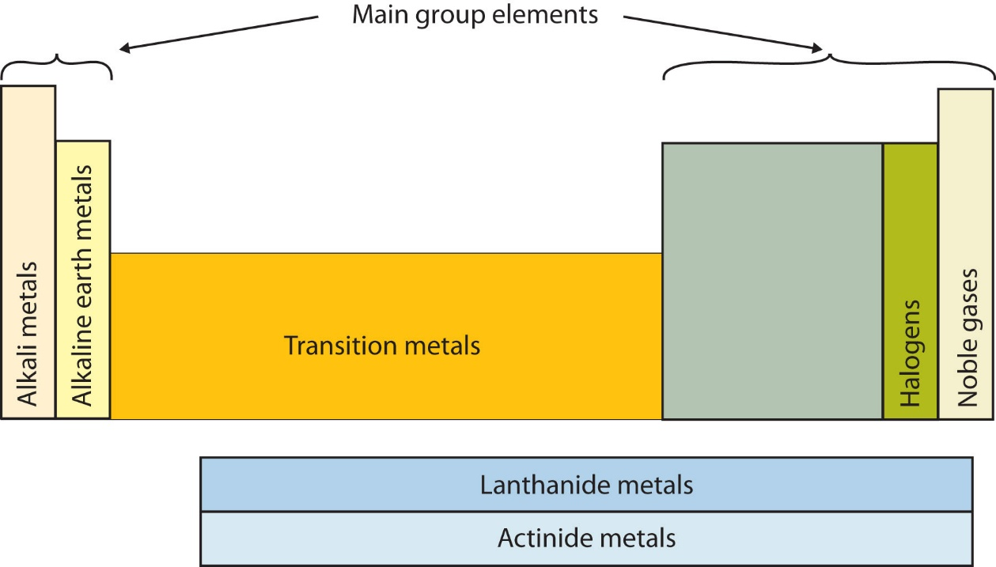
Special Groups of Elements
Some groups of elements should be noted since their chemistry is commonly observed

Slide 29
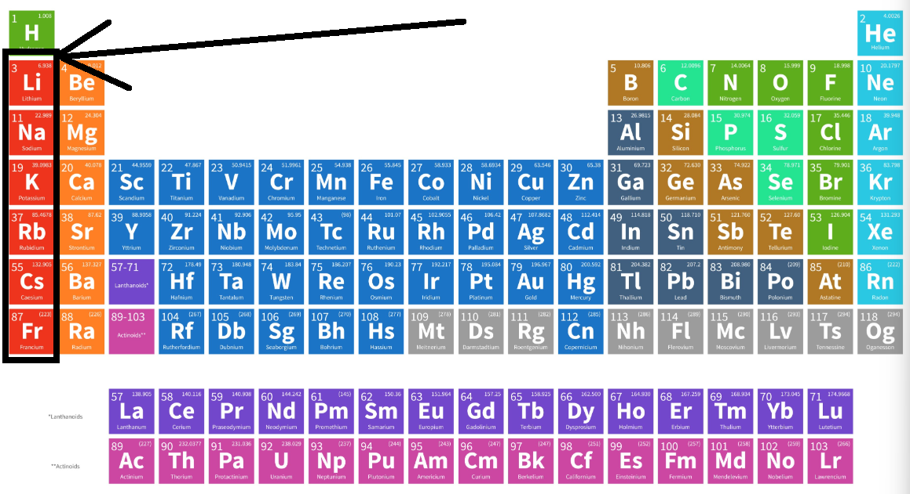

Special Groups of Elements
Alkali Metals
Sodium
table salt
cellular function
Potassium
cellular function (like sodium)
Lithium
used in “grease” lubricants
batteries
drugs to control neurological conditions affecting
behavior (bipolar “disorder”)

Slide 30
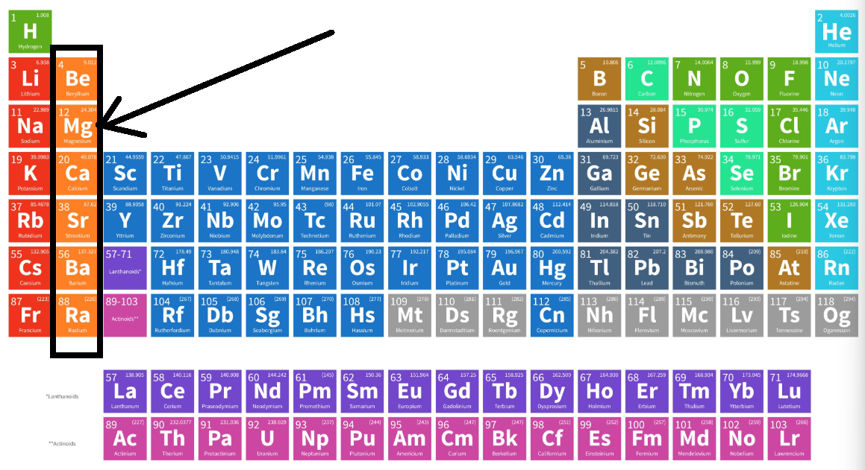

Special Groups of Elements
Alkaline Earth Metals
Magnesium:
also important in cellular function
Forms important minerals
Calcium:
Like magnesium, necessary for cell/tissue function
Limestone is calcium carbonate
Others are rare and Ra is radioactive

Slide 31
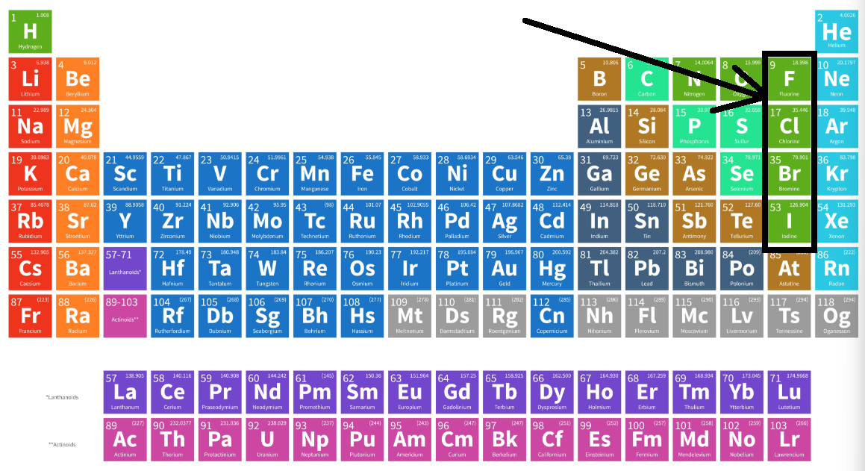

Special Groups of Elements
Halogens
Term “halogen” → salt-forming
React with metals to form salts
Fluorine:
the fluoride in toothpaste
non-stick Teflon
Chlorine:
essential for cellular function
a component of plastics (chlorides of carbon polymers)

Slide 32
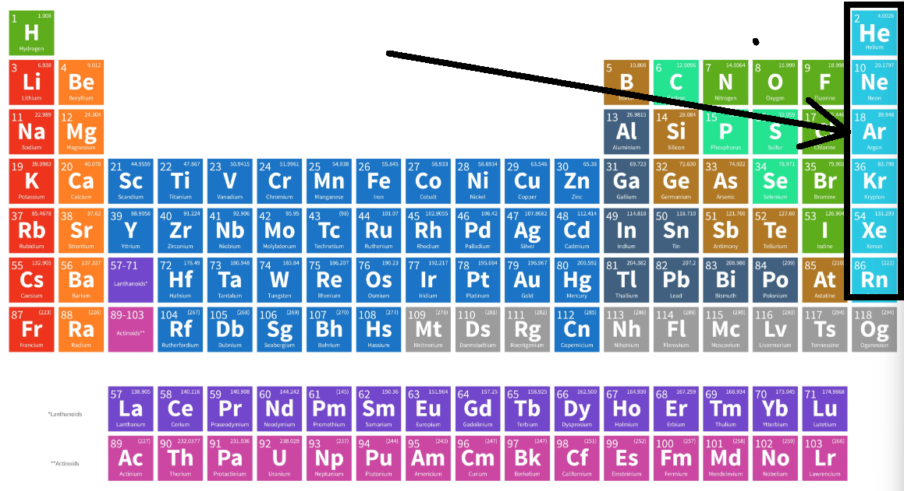

Special Groups of Elements
Noble Gases
Also called “inert gases” and
“rare gases”
Basically once thought to be
chemically unreactive
Usually exist as single atoms, explains
why gases neon used to make red lighting
But some form interesting compounds with
nonmetals
  Xenon hexafluoroplatinate (XePtF₆): first compound
  with noble gas ever produced
  Xenon difluoride (XeF₂): powerful fluorinating and
  oxidizing agent used in microprocessor production
  Krypton difluoride (KrF₂): used to make
  KrF excimer lasers for photolithography
  (ArF also used in this way)

Slide 33







Let’s Have Another Quiz

Slide 34





You Asked For More? Sure!

Slide 35
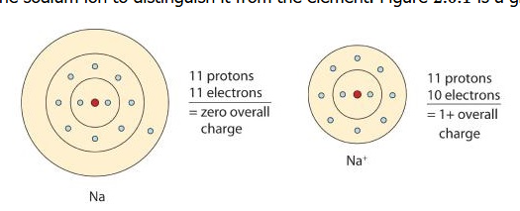
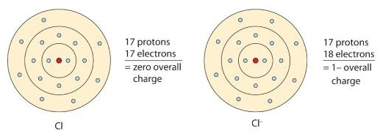
Electric properties of atoms: Ions
Ions
  Neutral atom/particle: zero charge, plus=minus
  Ions: positively or negatively charged atoms/particles
Cations – is a POSITIVELY charged ion
  Lose an electron
  Na ➔ Na⁺ + e⁻
Anions – is a NEGATIVELY charged ion
  Gain an electron
  e⁻ + Cl ➔ Cl⁻

Slide 36
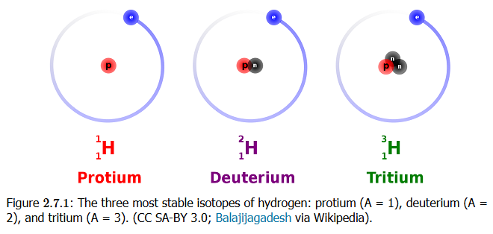
Isotopes
Isotopes are forms of an atom with the same proton number (Z) but different mass number (A)
That is, they are forms of an element with different numbers of neutrons in the atom

Slide 37
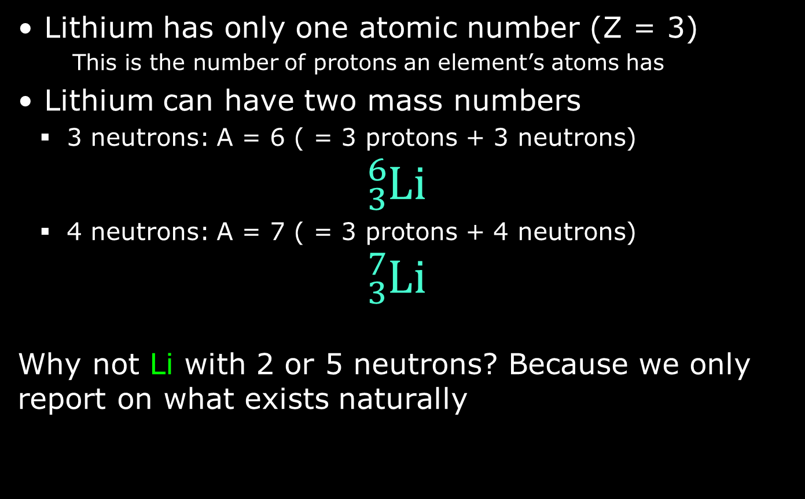
Isotopes
Lithium has only one atomic number (Z = 3)
    This is the number of protons an element’s atoms has
Lithium can have two mass numbers
  3 neutrons: A = 6 ( = 3 protons + 3 neutrons)
  $${}_{3}^{6}{\text{Li}}$$
  4 neutrons: A = 7 ( = 3 protons + 4 neutrons)
  $${}_{3}^{7}{\text{Li}}$$
Why not Li with 2 or 5 neutrons? Because we only report on what exists naturally

Slide 38
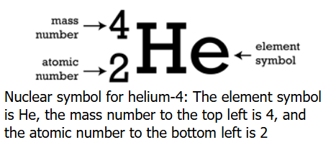
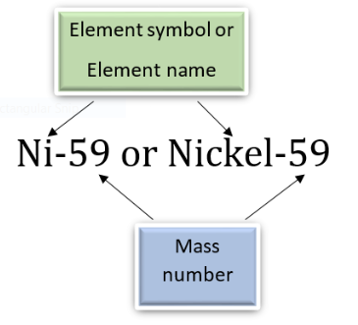
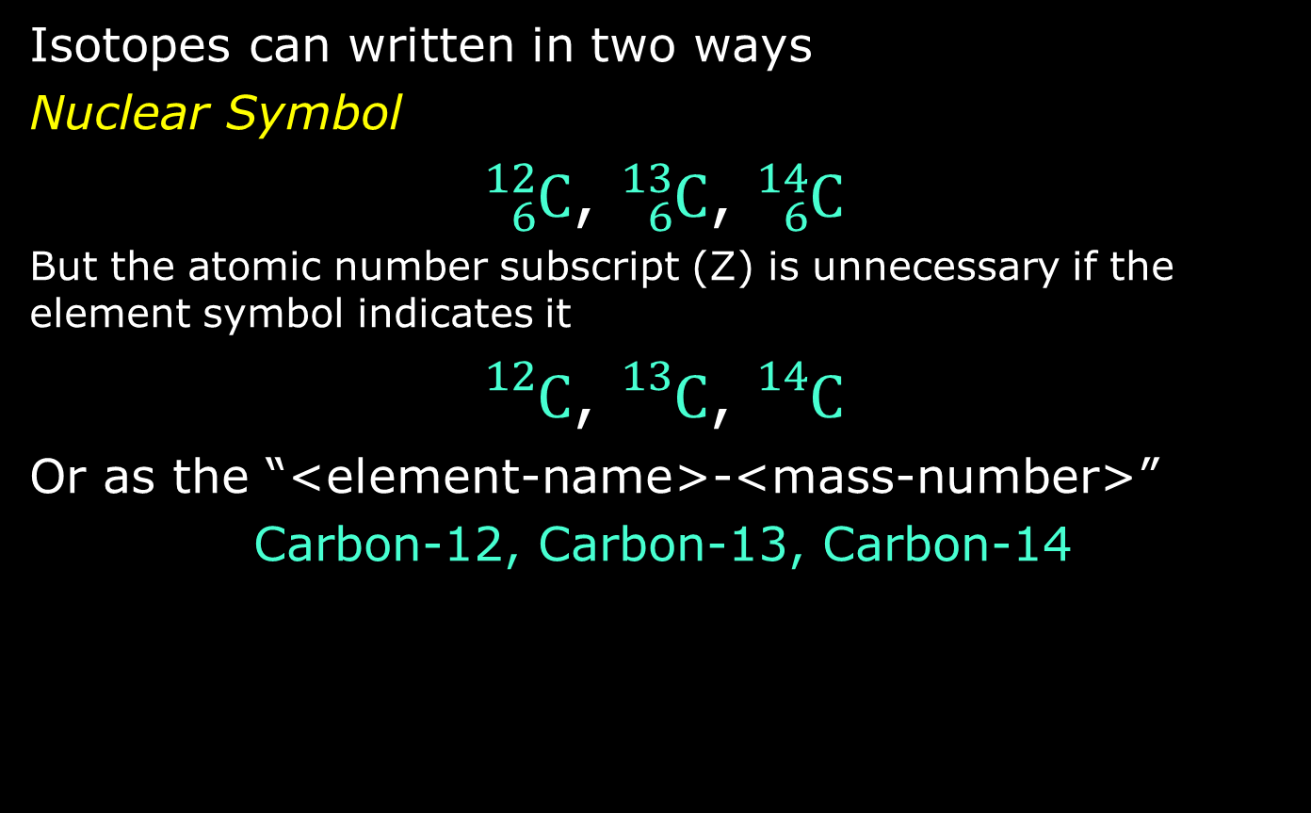
Representing Isotopes
Isotopes can written in two ways
Nuclear Symbol
${}_{6}^{12}{\text{C}}$, ${}_{6}^{13}{\text{C}}$, ${}_{6}^{14}{\text{C}}$
But the atomic number subscript (Z) is unnecessary if the element symbol indicates it
${}_{}^{12}{\text{C}}$, ${}_{}^{13}{\text{C}}$, ${}_{}^{14}{\text{C}}$
Or as the “<element-name>-<mass-number>”
Carbon-12, Carbon-13, Carbon-14

Slide 39
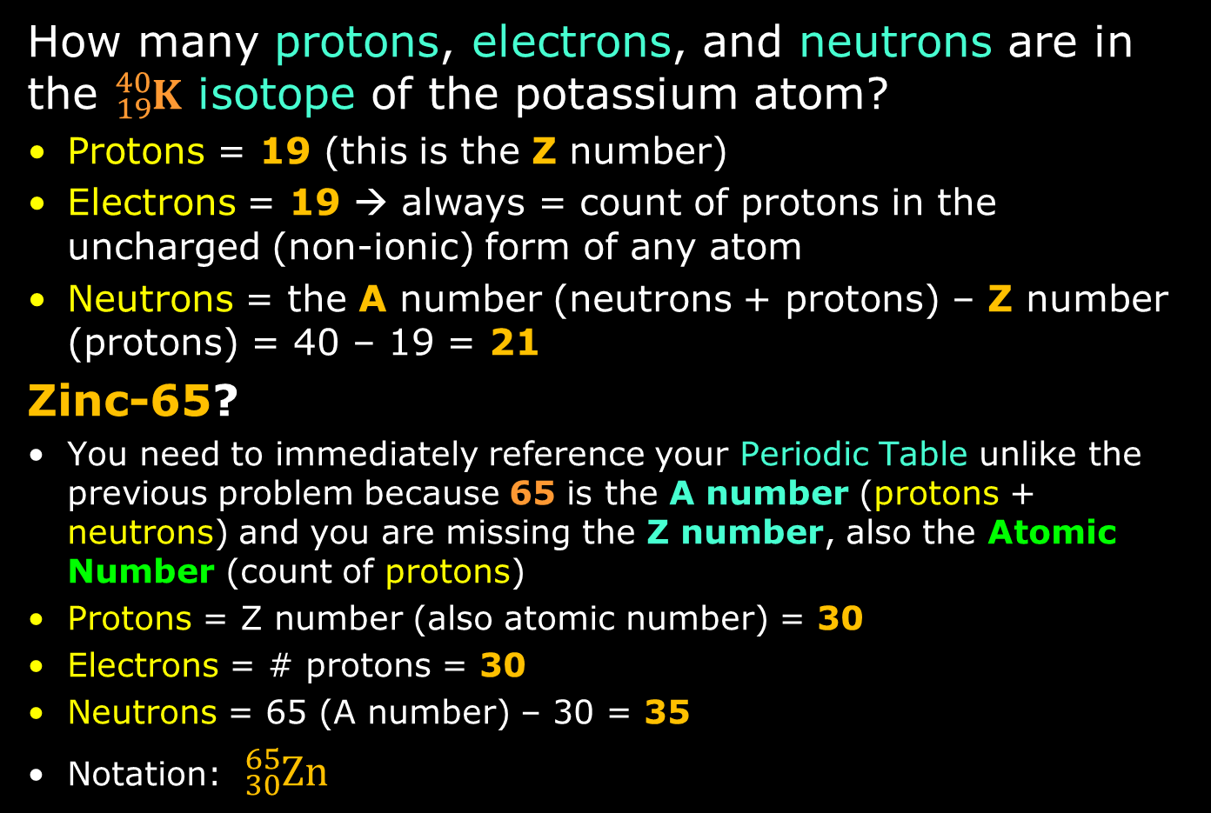
Practice Understanding Isotopes
How many protons, electrons, and neutrons are in the ${}_{19}^{40}K$ isotope of the potassium atom?
Protons = 19 (this is the Z number)
Electrons = 19 → always = count of protons in the uncharged (non-ionic) form of any atom
Neutrons = the A number (neutrons + protons) – Z number (protons) = 40 – 19 = 21
Zinc-65?
You need to immediately reference your Periodic Table unlike the previous problem because 65 is the A number (protons + neutrons) and you are missing the Z number, also the Atomic Number (count of protons)
Protons = Z number (also atomic number) = 30
Electrons = # protons = 30
Neutrons = 65 (A number) – 30 = 35
Notation: ${}_{30}^{65}{Zn}$

Slide 40
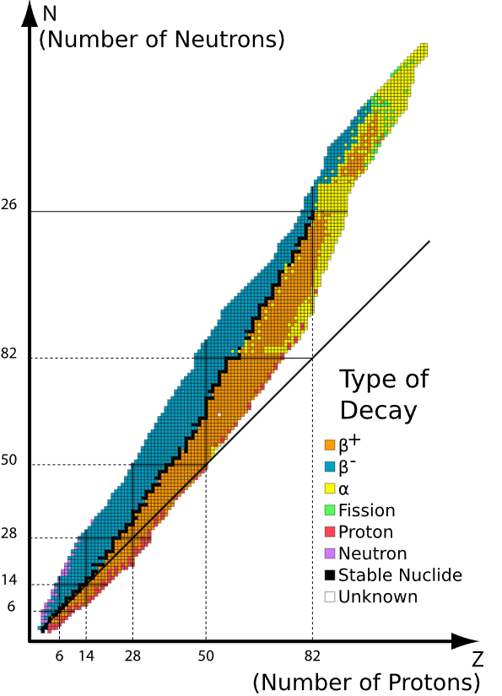
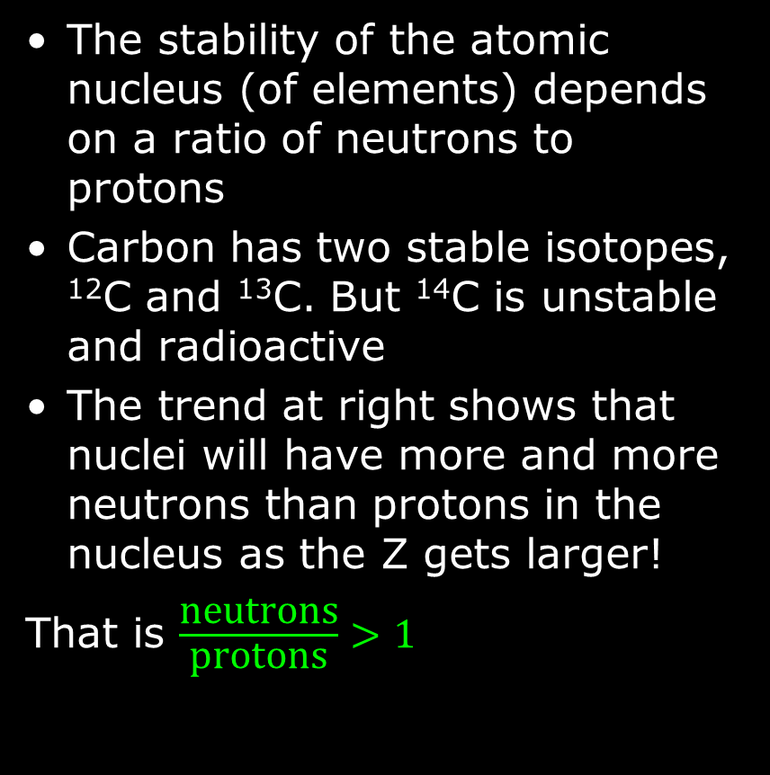
Isotope Stability
The stability of the atomic nucleus (of elements) depends on a ratio of neutrons to protons
Carbon has two stable isotopes, ¹²C and ¹³C. But ¹⁴C is unstable and radioactive
The trend at right shows that nuclei will have more and more neutrons than protons in the nucleus as the Z gets larger!
That is $\frac{\text{neutrons}}{\text{protons}}>1$

Slide 41
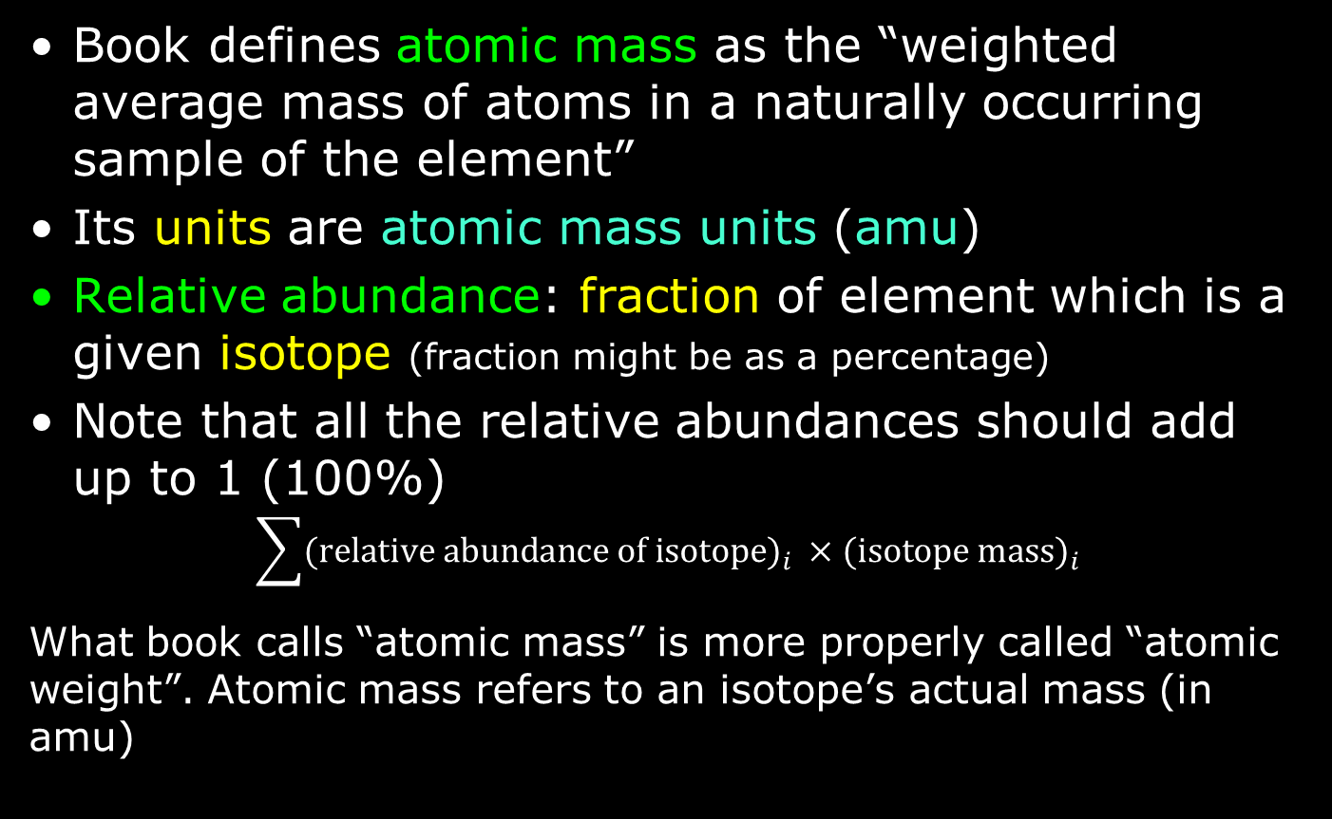
Table Atomic Mass: A Weighted Average
Book defines atomic mass as the “weighted average mass of atoms in a naturally occurring sample of the element”
Its units are atomic mass units (amu)
Relative abundance: fraction of element which is a given isotope (fraction might be as a percentage)
Note that all the relative abundances should add up to 1 (100%)
$$\sum{{\text{(relative abundance of isotope)}}_{i} ×{\text{(}\text{isotope mass)}}_{i}}$$
What book calls “atomic mass” is more properly called “atomic weight”. Atomic mass refers to an isotope’s actual mass (in amu)

Slide 42
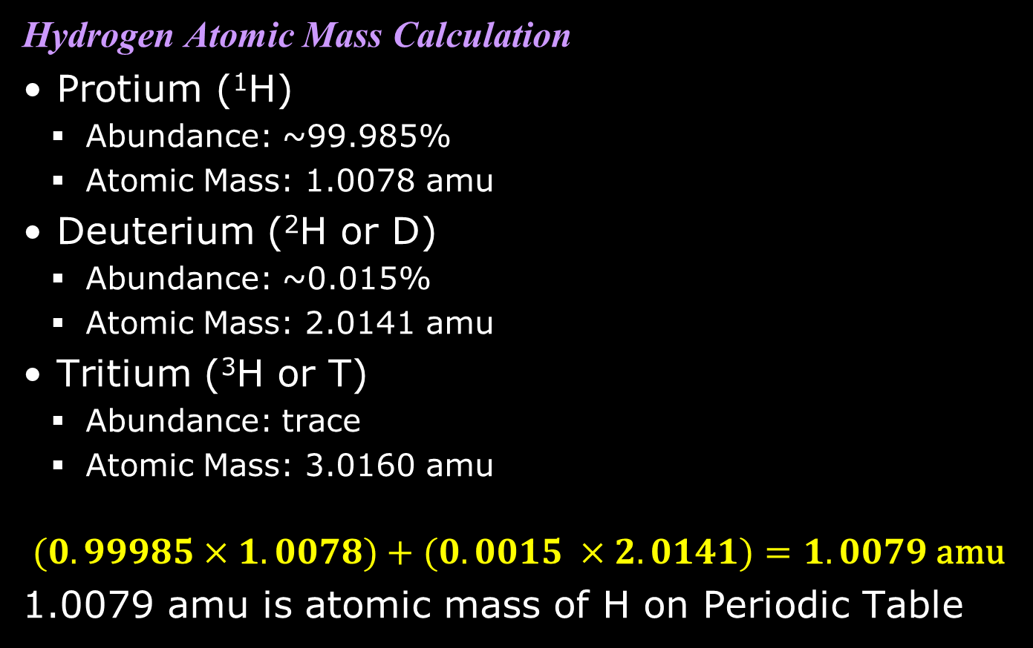
Atomic Mass Calculation
Hydrogen Atomic Mass Calculation
Protium (¹H)
  Abundance: ~99.985%
  Atomic Mass: 1.0078 amu
Deuterium (²H or D)
  Abundance: ~0.015%
  Atomic Mass: 2.0141 amu
Tritium (³H or T)
  Abundance: trace
  Atomic Mass: 3.0160 amu
$$(0.99985×1.0078)+(0.0015 ×2.0141)=1.0079 \text{amu}$$
1.0079 amu is atomic mass of H on Periodic Table

Slide 43
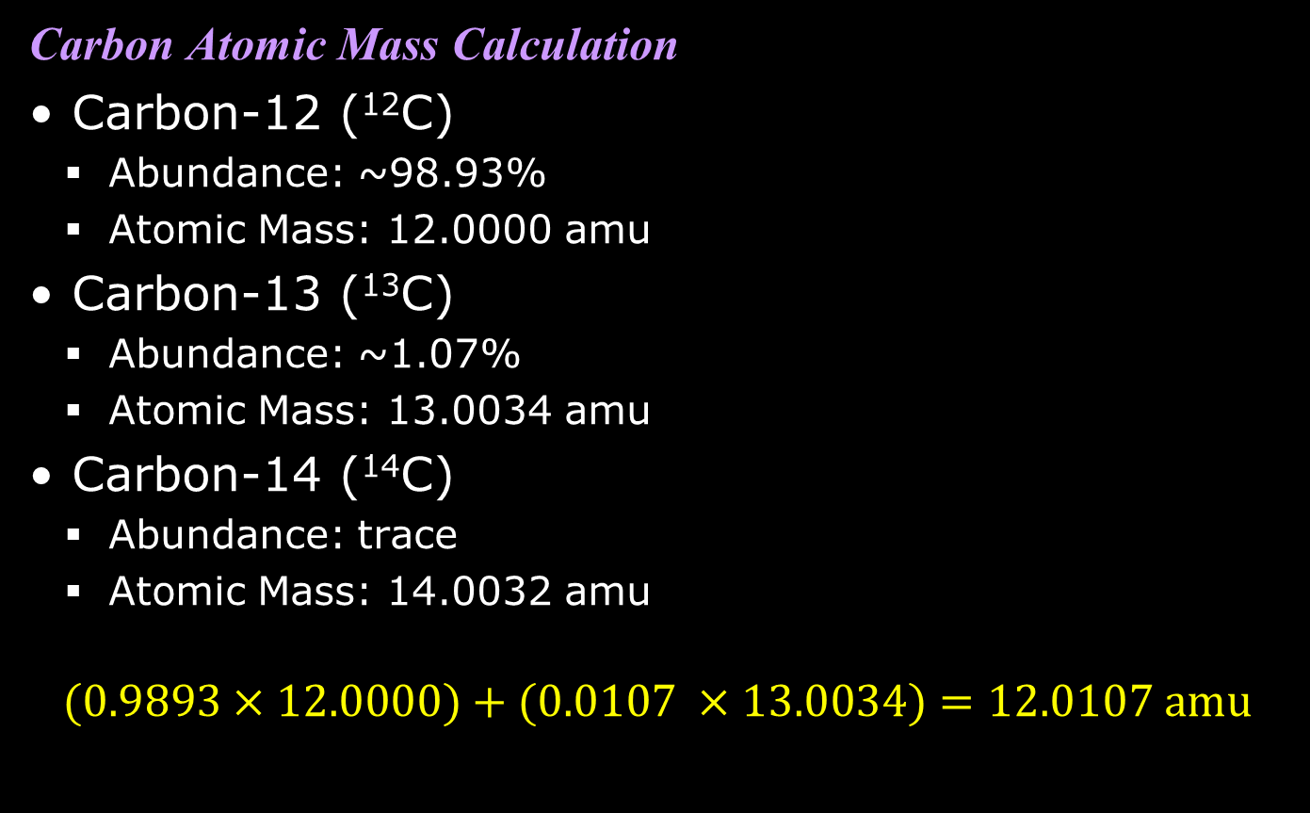
Atomic Mass Calculation
Carbon Atomic Mass Calculation
Carbon-12 (¹²C)
  Abundance: ~98.93%
  Atomic Mass: 12.0000 amu
Carbon-13 (¹³C)
  Abundance: ~1.07%
  Atomic Mass: 13.0034 amu
Carbon-14 (¹⁴C)
  Abundance: trace
  Atomic Mass: 14.0032 amu
$$(0.9893×12.0000)+(0.0107 ×13.0034)=12.0107 \text{amu}$$

Slide 44
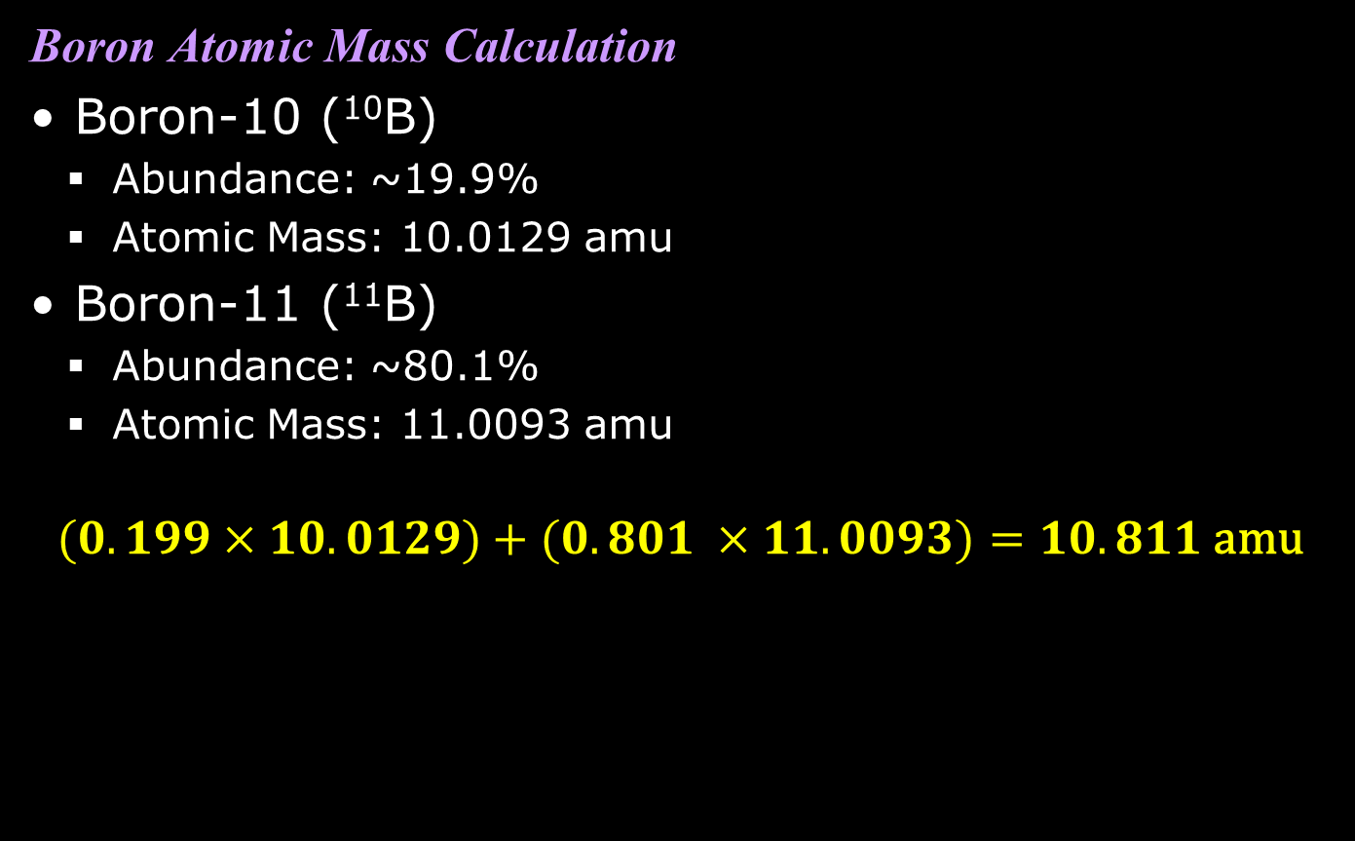
Atomic Mass Calculation
Boron Atomic Mass Calculation
Boron-10 (¹⁰B)
  Abundance: ~19.9%
  Atomic Mass: 10.0129 amu
Boron-11 (¹¹B)
  Abundance: ~80.1%
  Atomic Mass: 11.0093 amu
$$(0.199×10.0129)+(0.801 ×11.0093)=10.811 \text{amu}$$

Slide 45
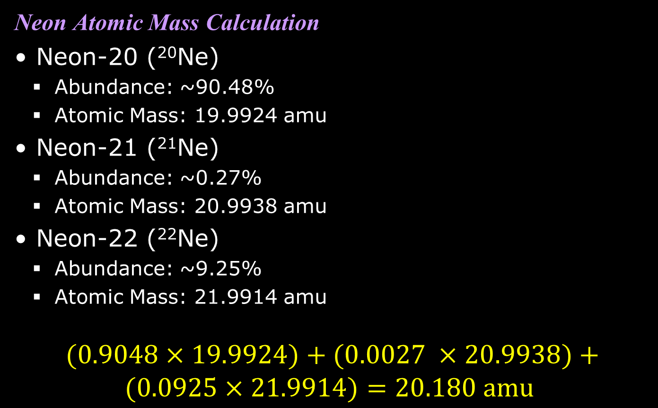
Atomic Mass Calculation
Neon Atomic Mass Calculation
Neon-20 (²⁰Ne)
  Abundance: ~90.48%
  Atomic Mass: 19.9924 amu
Neon-21 (²¹Ne)
  Abundance: ~0.27%
  Atomic Mass: 20.9938 amu
Neon-22 (²²Ne)
  Abundance: ~9.25%
  Atomic Mass: 21.9914 amu
$$(0.9048×19.9924)+(0.0027 ×20.9938)+ \\ (0.0925×21.9914)=20.180 \text{amu}$$

